Slide 1
Project 6
Bank Loan Case Study
From: Avinash Nayak
Hyperlink to the iPython Notebook:
https://drive.google.com/file/d/1bsoxlYZterdzEEcWxLhuiL1aDeOzWBiq/view?usp=sharing

Slide 2

Project Description
This Project is about analyzing patterns in the bank loan data to ensure that capable loan applicants are not rejected.
These insights will be helpful for bank managers and other stakeholders to determine which applicant will have difficulty in paying their installments
As a Data Analyst, we received dataset with details about applicants who have applied for loan and queries and we are required to analyze the data and provide insights to those queries.
To do this, we will use Python programming language for data pre-processing and EDA to get the required insights.
Image Source: Google Images

Slide 3

Approach
We had received a dataset containing information about loan applications like income of applicant, credit amount, disposable income details like car ownership, home ownership etc.
We first tried to understand the whole dataset.
Then we performed Data Pre-Processing where we checked and did necessary changes for missing data, error in data, outliers in data and duplicates in data.
Then we directly started peforming EDA as per the queries we had. We also plotted some graphs for better understanding. Then we drew conclusions and insights based on the filtered data and the plots.
Now, since we got all the insights required, we will make a detailed report about it and hand them over to the required department.
Image Source: Google Images

Slide 4


Tech-Stack Used
Python 3.10.9 – Programming language used for Data Pre-processing and EDA
Jupyter Notebook 6.5.2 – Interactive platform to write and execute codes in various programming languages (in this case Python).
Image Source: Google Images

Slide 5
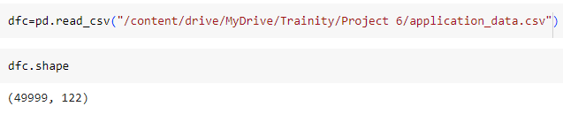
Dataset Information
The Dataset named applications_data.csv has 49999 rows (datapoints) and 122 columns (features).
Details about Features of the Dataset can be found in the below Spreadsheet:
https://docs.google.com/spreadsheets/d/1SC-Cd-ICOxiIpr0AUlEHw0tMz1ypO9V5/edit?usp=sharing&ouid=115294475465194571559&rtpof=true&sd=true

Slide 6
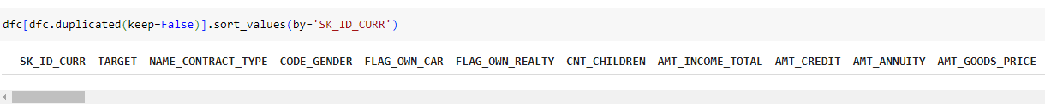
Data Pre-Processing
● Checking for Duplicate Data
1. Checking for duplicates of entire row
2. Checking for duplicates of SK_ID_CURR column
Result:
From the above analysis, we observed that there was no duplicate row as well as duplicate SK_ID_CURR value.

Slide 7
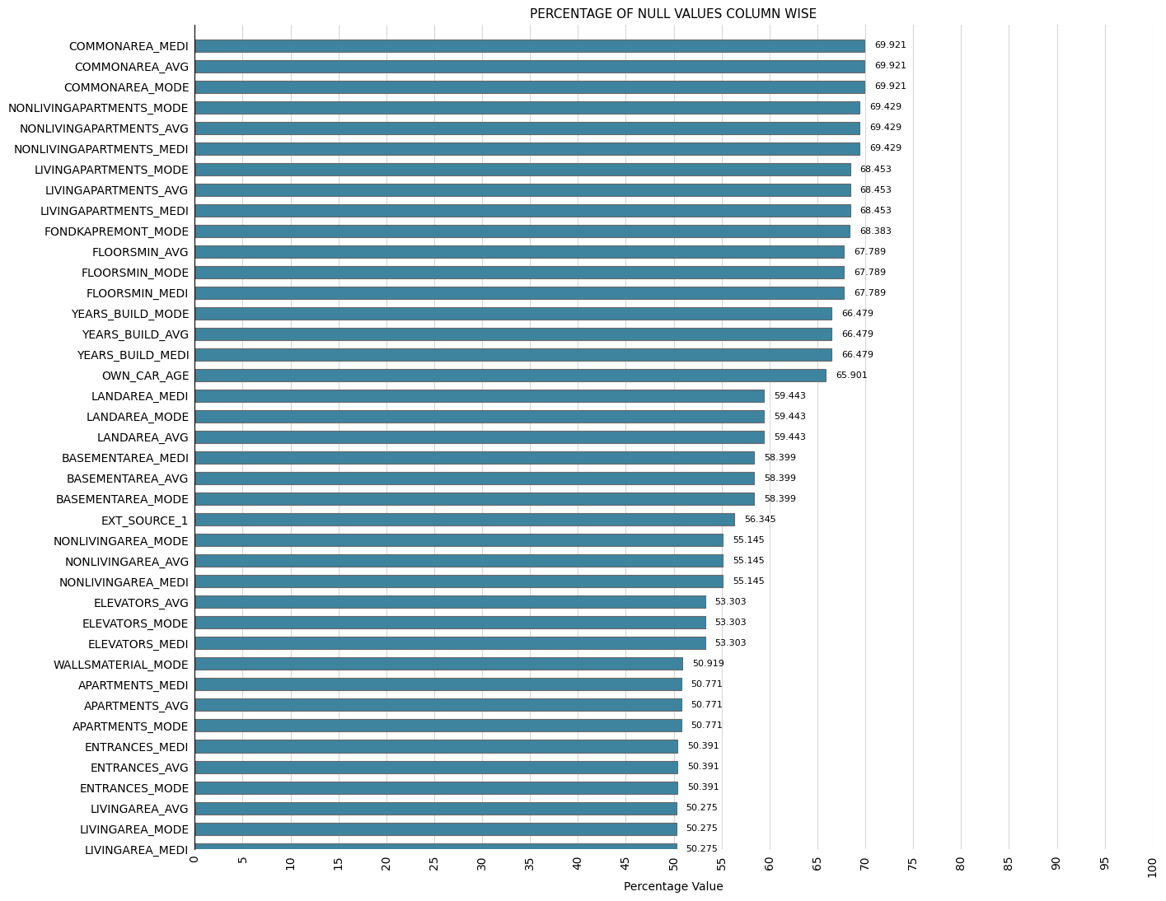
A. Identify Missing Data and Deal with it Appropriately: As a data analyst, you come across missing data in the loan application dataset. It is essential to handle missing data effectively to ensure the accuracy of the analysis.
Task: Identify the missing data in the dataset and decide on an appropriate method to deal with it using Excel built-in functions and features.
3. Checking for null values column wise

Slide 8
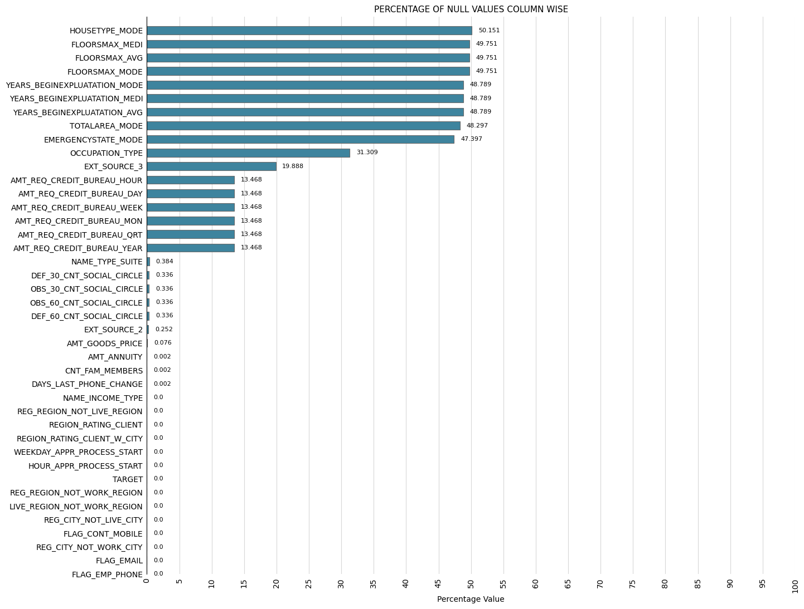
A. Identify Missing Data and Deal with it Appropriately: As a data analyst, you come across missing data in the loan application dataset. It is essential to handle missing data effectively to ensure the accuracy of the analysis.
Task: Identify the missing data in the dataset and decide on an appropriate method to deal with it using Excel built-in functions and features.
3. Checking for null values column wise

Slide 9
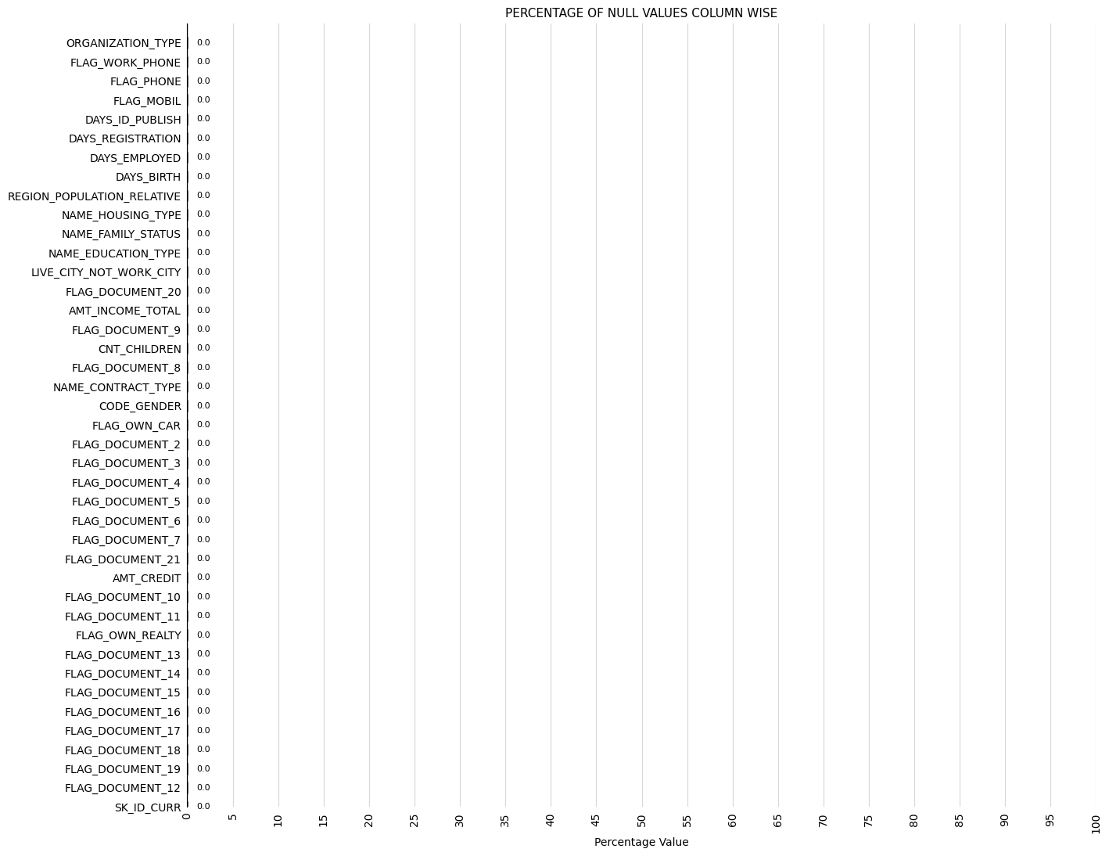
A. Identify Missing Data and Deal with it Appropriately: As a data analyst, you come across missing data in the loan application dataset. It is essential to handle missing data effectively to ensure the accuracy of the analysis.
Task: Identify the missing data in the dataset and decide on an appropriate method to deal with it using Excel built-in functions and features.
3. Checking for null values column wise

Slide 10
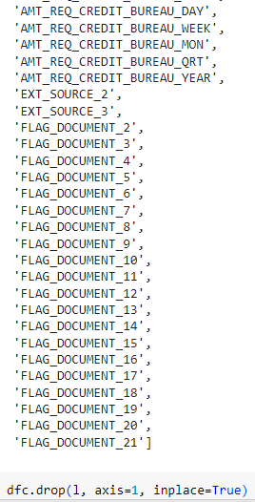
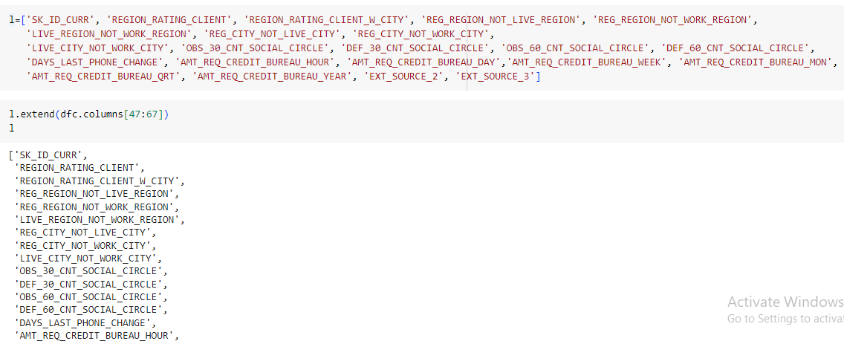
A. Identify Missing Data and Deal with it Appropriately: As a data analyst, you come across missing data in the loan application dataset. It is essential to handle missing data effectively to ensure the accuracy of the analysis.
Task: Identify the missing data in the dataset and decide on an appropriate method to deal with it using Excel built-in functions and features.
4. Dealing with Null Values
Dropping all the columns where number of null values is greater than 40%
Also dropping all the unimportant columns

Slide 11
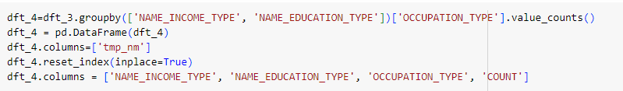
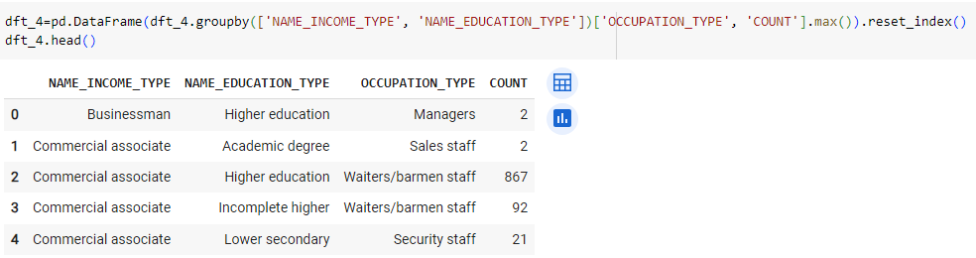
A. Identify Missing Data and Deal with it Appropriately: As a data analyst, you come across missing data in the loan application dataset. It is essential to handle missing data effectively to ensure the accuracy of the analysis.
Task: Identify the missing data in the dataset and decide on an appropriate method to deal with it using Excel built-in functions and features.
5. Dealing with Null values in OCCUPATION_TYPE column
We will replace null values of OCCUPATION_TYPE column with values which have the maximum count of the value of NAME_INCOME_TYPE and NAME_EDUCATION_TYPE of the corresponding null value

Slide 12
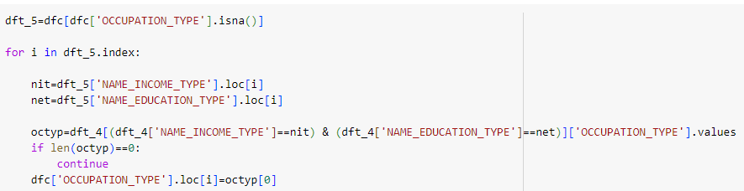
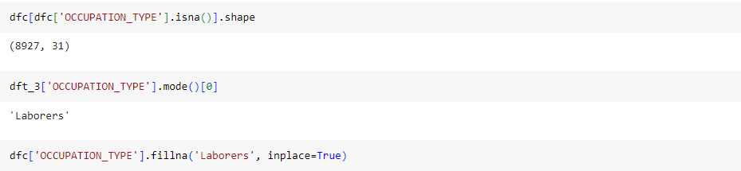
A. Identify Missing Data and Deal with it Appropriately: As a data analyst, you come across missing data in the loan application dataset. It is essential to handle missing data effectively to ensure the accuracy of the analysis.
Task: Identify the missing data in the dataset and decide on an appropriate method to deal with it using Excel built-in functions and features.
We find that there are still null value in OCCUPATION_TYPE column after above step. We replaced such null values with Laborers which is the most common Occupation type.

Slide 13
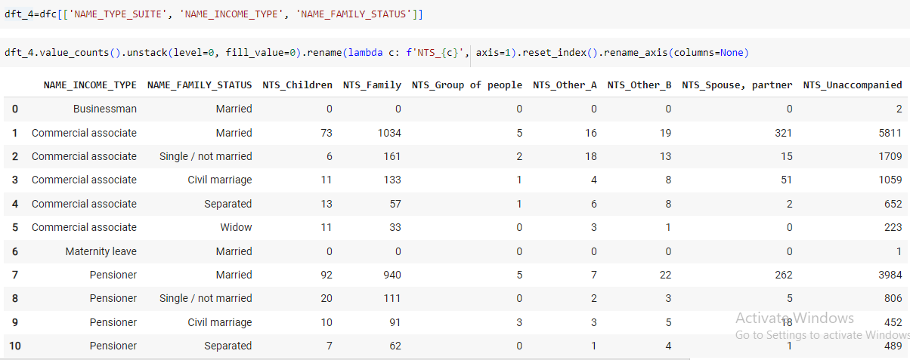
A. Identify Missing Data and Deal with it Appropriately: As a data analyst, you come across missing data in the loan application dataset. It is essential to handle missing data effectively to ensure the accuracy of the analysis.
Task: Identify the missing data in the dataset and decide on an appropriate method to deal with it using Excel built-in functions and features.
6. Dealing with Null values in NAME_TYPE_SUITE column
We will replace null values of NAME_TYPE_SUITE column with values which have the maximum count of the value of NAME_INCOME_TYPE and NAME_FAMILY_STATUS of the corresponding null value
For all the column values of NAME_INCOME_TYPE and NAME_FAMILY_STATUS, the most common column value of NAME_TYPE_SUITE is Unaccompanied. So replacing all null values of NAME_TYPE_SUITE with Unaccompanied

Slide 14
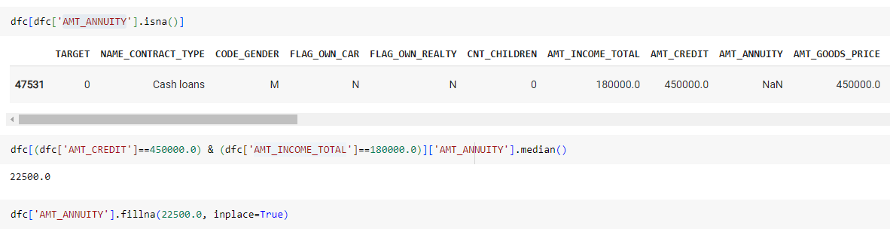
A. Identify Missing Data and Deal with it Appropriately: As a data analyst, you come across missing data in the loan application dataset. It is essential to handle missing data effectively to ensure the accuracy of the analysis.
Task: Identify the missing data in the dataset and decide on an appropriate method to deal with it using Excel built-in functions and features.
7. Dealing with Null values in AMT_GOODS_PRICE column
We will replace null values of AMT_GOODS_PRICE with the corresponding row value of AMT_CREDIT column
8. Dealing with Null values in AMT_ANNUITY column
We will replace null values of AMT_ANNUITY with the median value of AMT_ANNUITY for all rows with corresponding value of AMT_CREDIT and AMT_INCOME_TOTAL
9. Dealing with Null values in CNT_FAM_MEMBERS column
We will replace null values of CNT_FAM_MEMBERS with the median value of CNT_FAM_MEMBERS

Slide 15
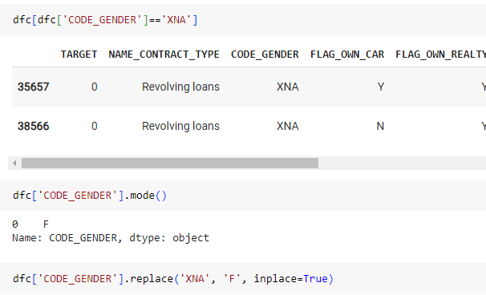
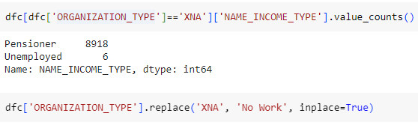
A. Identify Missing Data and Deal with it Appropriately: As a data analyst, you come across missing data in the loan application dataset. It is essential to handle missing data effectively to ensure the accuracy of the analysis.
Task: Identify the missing data in the dataset and decide on an appropriate method to deal with it using Excel built-in functions and features.
10. Dealing with errors in GENDER column
11. Dealing with errors in ORGANIZATION_TYPE column
We found some error values in GENDER column. Replaced them with F (Female) which is the most common gender
We found some error values in ORGANIZATION_TYPE column. Replaced them with No Work as these people were pensioners and unemployed

Slide 16
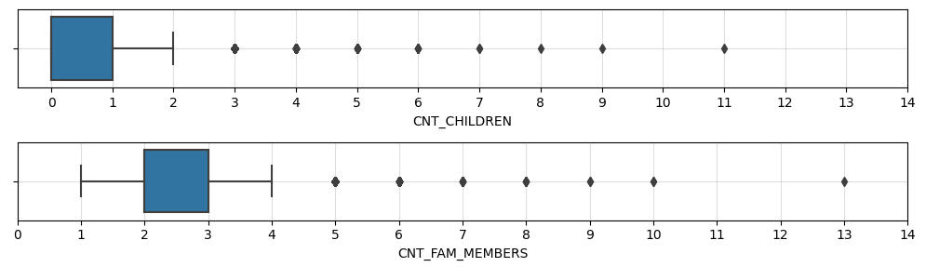
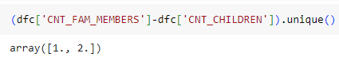
B. Identify Outliers in the Dataset: Outliers can significantly impact the analysis and distort the results. You need to identify outliers in the loan application dataset.
Task: Detect and identify outliers in the dataset using Excel statistical functions and features, focusing on numerical variables.
12. Dealing with Outliers in CNT_CHILDREN and CNT_FAM_MEMBERS column
Action:
Checked for number of Parents for all row values. Found no issues.

Slide 17
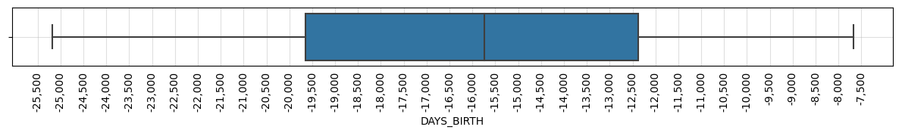
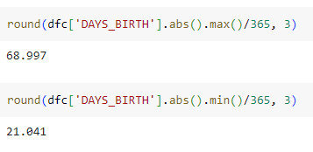
B. Identify Outliers in the Dataset: Outliers can significantly impact the analysis and distort the results. You need to identify outliers in the loan application dataset.
Task: Detect and identify outliers in the dataset using Excel statistical functions and features, focusing on numerical variables.
13. Dealing with Outliers in DAYS_BIRTH column
Action:
Checked the maximum and minimum age. No issue found.

Slide 18
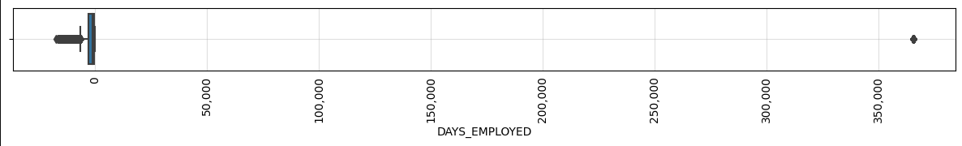
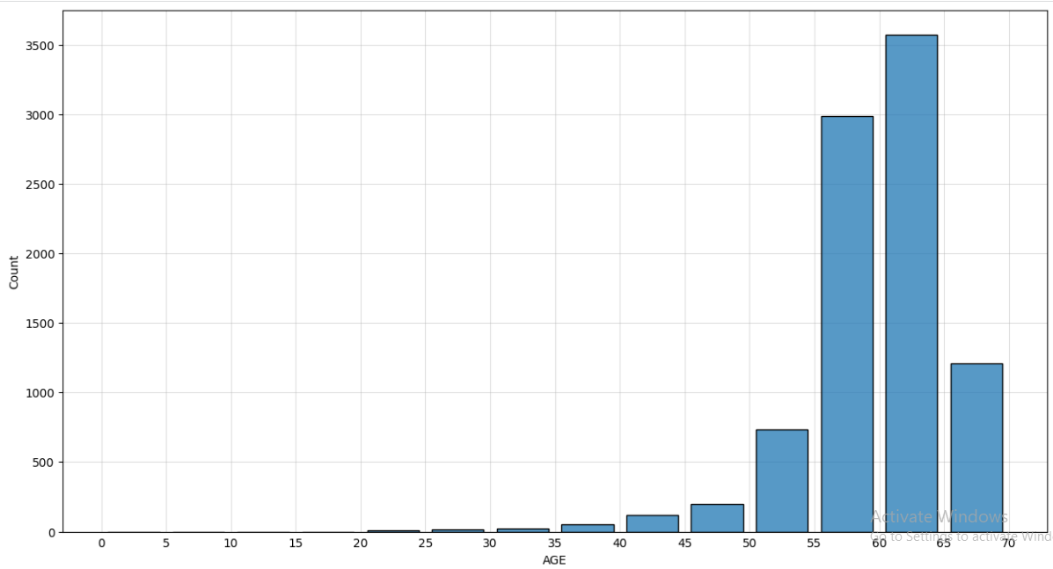
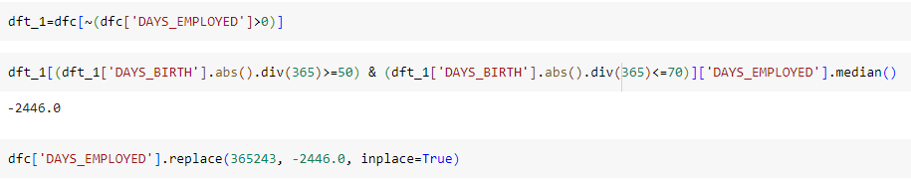
B. Identify Outliers in the Dataset: Outliers can significantly impact the analysis and distort the results. You need to identify outliers in the loan application dataset.
Task: Detect and identify outliers in the dataset using Excel statistical functions and features, focusing on numerical variables.
14. Dealing with Outliers in DAYS_EMPLOYED column
Action:
In above Box plot, the positive value is an outlier. We checked for distribution of AGE for all rows which have positive value of DAYS_EMPLOYED. We found that most of the AGE values were above 50. So we replaced the positive value of DAYS_EMPLOYED with median value of DAYS_EMPLOYED for rows which have AGE greater than equal to 50.

Slide 19
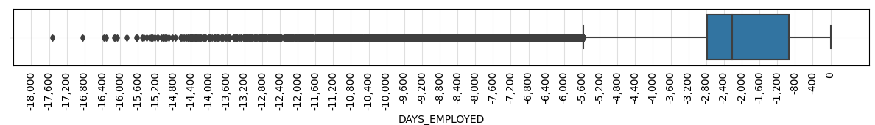
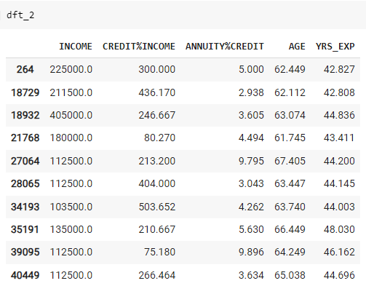
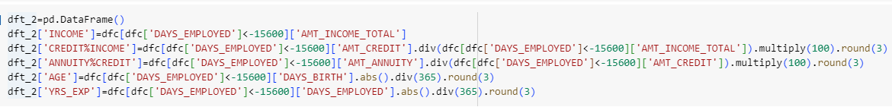
B. Identify Outliers in the Dataset: Outliers can significantly impact the analysis and distort the results. You need to identify outliers in the loan application dataset.
Task: Detect and identify outliers in the dataset using Excel statistical functions and features, focusing on numerical variables.
We again checked for outliers in DAYS_EMPLOYED using Box plot.
Action:
We considered value less than -15600 as outliers. Calculated Credit percentage of Income, Annuity percentage of Income, Age in years, Experience in Years. Found no issues.

Slide 20
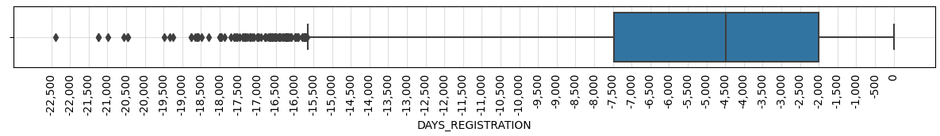
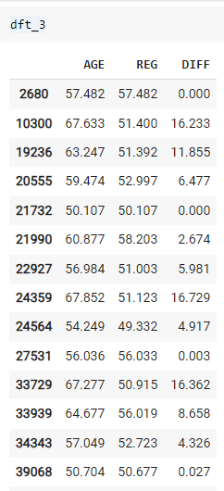
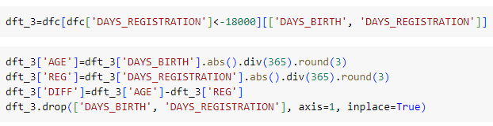
B. Identify Outliers in the Dataset: Outliers can significantly impact the analysis and distort the results. You need to identify outliers in the loan application dataset.
Task: Detect and identify outliers in the dataset using Excel statistical functions and features, focusing on numerical variables.
15. Dealing with Outliers in DAYS_REGISTRATION column
Action:
We considered value less than -18000 as outliers. Calculated Age in years, Registration in Years and Difference between Age and Registration for all those rows. Found no issues.

Slide 21
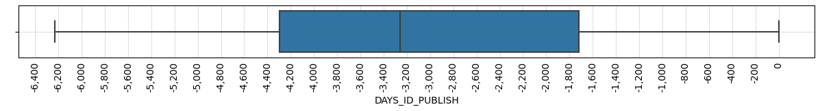
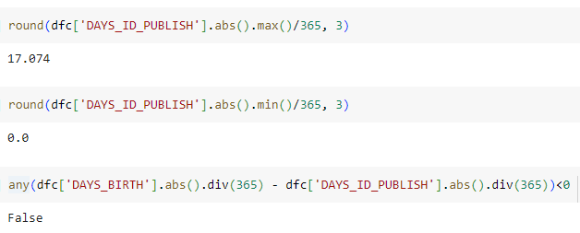
B. Identify Outliers in the Dataset: Outliers can significantly impact the analysis and distort the results. You need to identify outliers in the loan application dataset.
Task: Detect and identify outliers in the dataset using Excel statistical functions and features, focusing on numerical variables.
16. Dealing with Outliers in DAYS_ID_PUBLISH column
Action:
Checked the maximum and minimum age and difference between age and DAYS_ID_PUBLISH in years. No issue found.

Slide 22
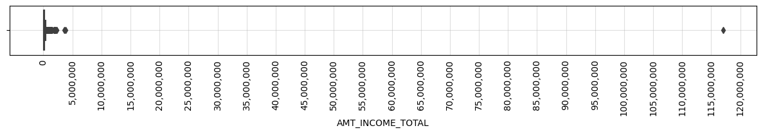
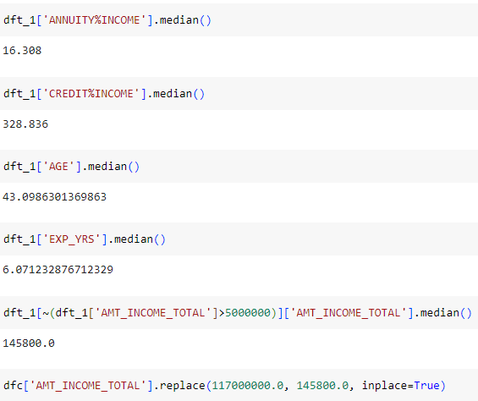
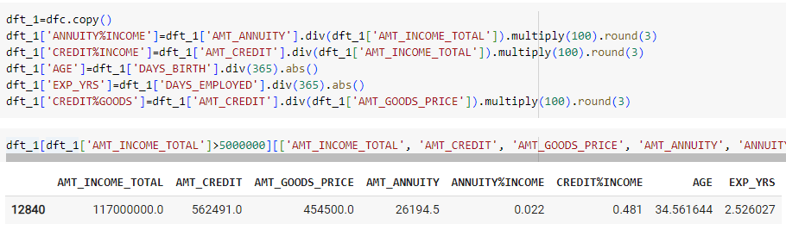
B. Identify Outliers in the Dataset: Outliers can significantly impact the analysis and distort the results. You need to identify outliers in the loan application dataset.
Task: Detect and identify outliers in the dataset using Excel statistical functions and features, focusing on numerical variables.
17. Dealing with Outliers in AMT_INCOME_TOTAL column
Action:
We considered value greater than 5000000 as outlier. We compared various row values of the particular row with median values of the columns and found large differences. So replaced the above outlier value with median value.

Slide 23
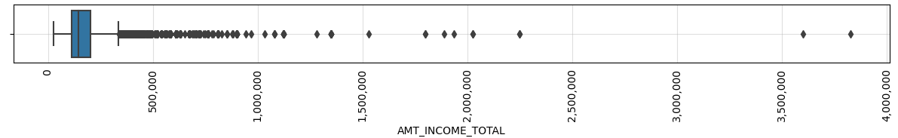
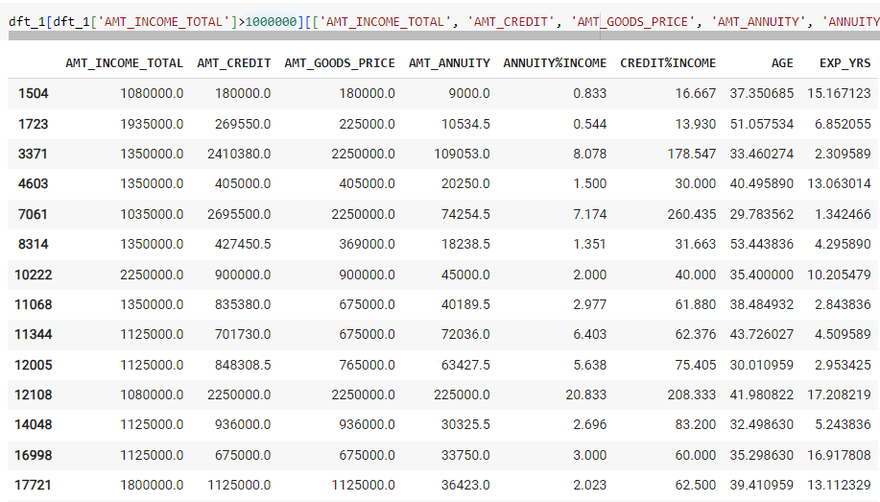
B. Identify Outliers in the Dataset: Outliers can significantly impact the analysis and distort the results. You need to identify outliers in the loan application dataset.
Task: Detect and identify outliers in the dataset using Excel statistical functions and features, focusing on numerical variables.
We again checked for outliers in AMT_INCOME_TOTAL using Box plot.
Action:
We considered values greater than 1000000 as outliers and checked for any possible issues for rows with AMT_INCOME_TOTAL greater than 1000000. Found no issues.

Slide 24
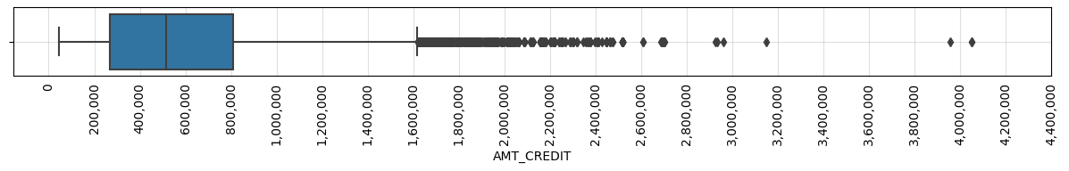
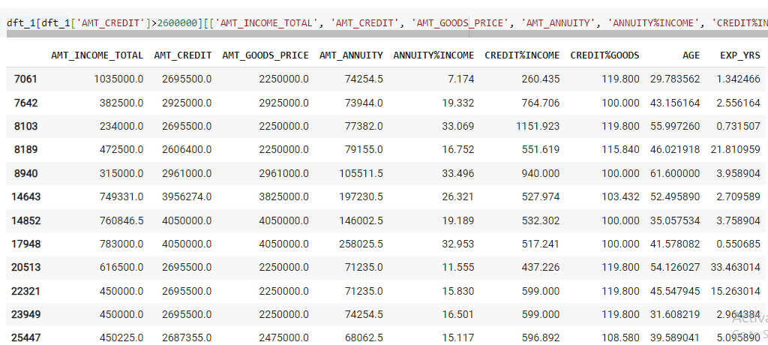
B. Identify Outliers in the Dataset: Outliers can significantly impact the analysis and distort the results. You need to identify outliers in the loan application dataset.
Task: Detect and identify outliers in the dataset using Excel statistical functions and features, focusing on numerical variables.
18. Dealing with Outliers in AMT_CREDIT column
Action:
We considered values greater than 2600000 as outliers and checked for any possible issues for rows with AMT_CREDIT greater than 2600000. Found no issues.

Slide 25
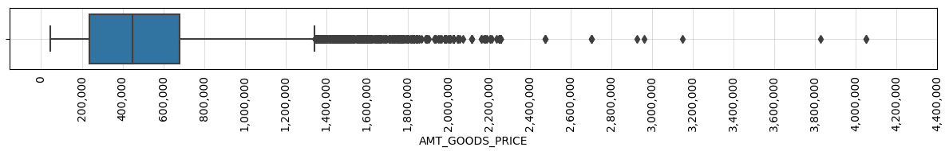
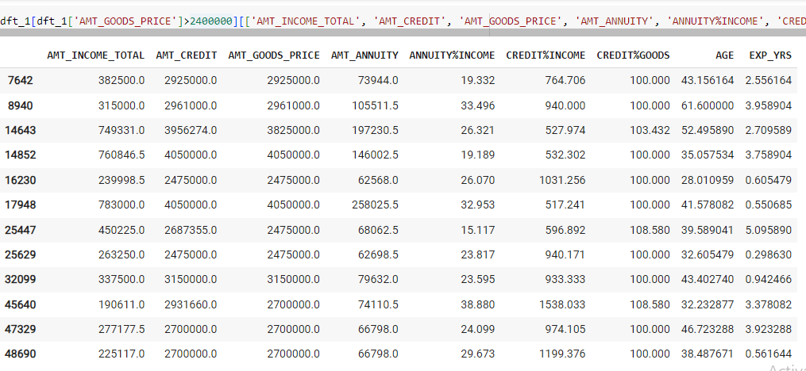
B. Identify Outliers in the Dataset: Outliers can significantly impact the analysis and distort the results. You need to identify outliers in the loan application dataset.
Task: Detect and identify outliers in the dataset using Excel statistical functions and features, focusing on numerical variables.
19. Dealing with Outliers in AMT_GOODS_PRICE column
Action:
We considered values greater than 2400000 as outliers and checked for any possible issues for rows with AMT_GOODS_PRICE greater than 2400000. Found no issues.

Slide 26
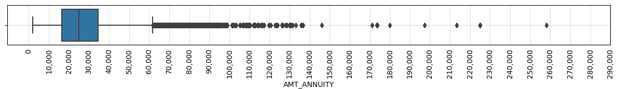
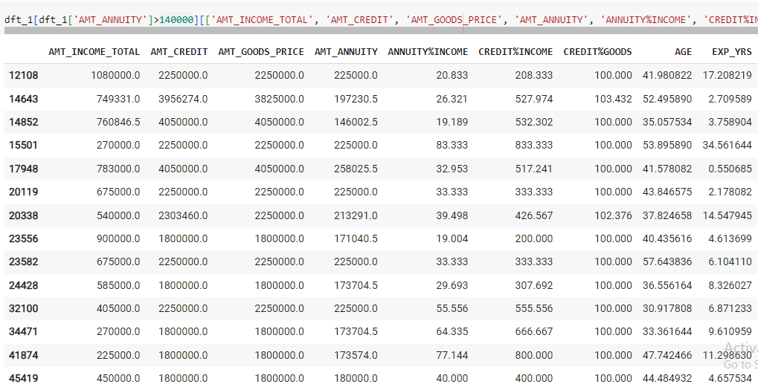
B. Identify Outliers in the Dataset: Outliers can significantly impact the analysis and distort the results. You need to identify outliers in the loan application dataset.
Task: Detect and identify outliers in the dataset using Excel statistical functions and features, focusing on numerical variables.
20. Dealing with Outliers in AMT_ANNUITY column
Action:
We considered values greater than 140000 as outliers and checked for any possible issues for rows with AMT_ANNUITY greater than 140000. Found no issues.

Slide 27
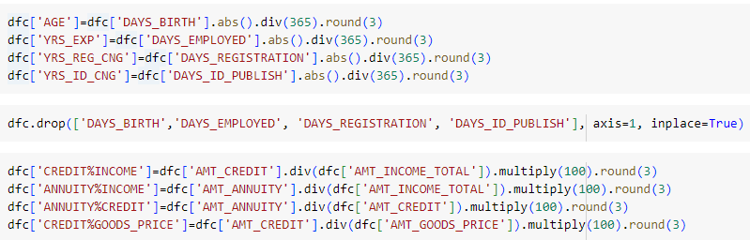
Data Pre-Processing
21. Feature Engineering

Slide 28
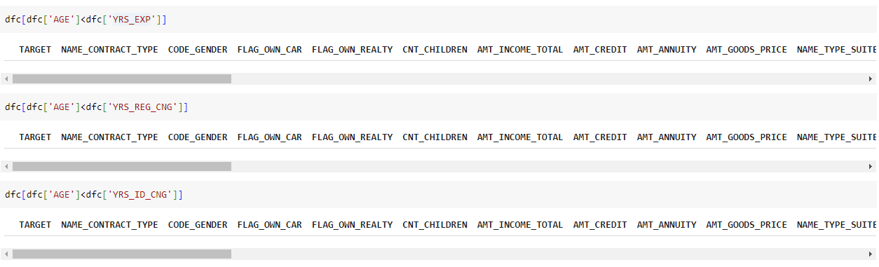
B. Identify Outliers in the Dataset: Outliers can significantly impact the analysis and distort the results. You need to identify outliers in the loan application dataset.
Task: Detect and identify outliers in the dataset using Excel statistical functions and features, focusing on numerical variables.
22. Checking if values of YRS_EXP, YRS_REG_CNG, YRS_ID_CNG are more than AGE

Slide 29
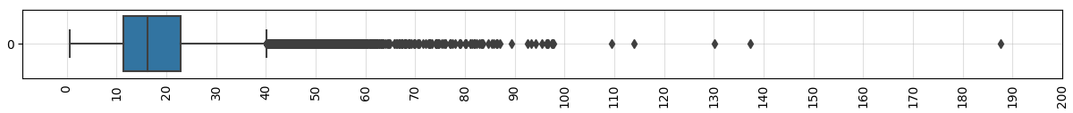
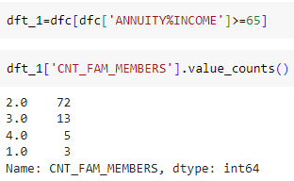
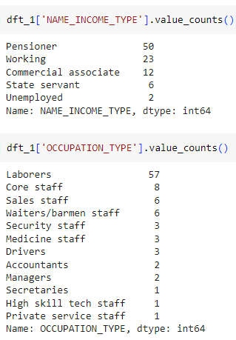
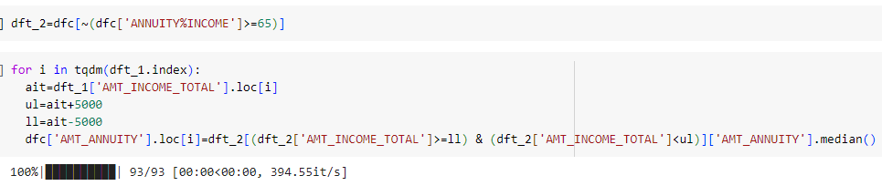
B. Identify Outliers in the Dataset: Outliers can significantly impact the analysis and distort the results. You need to identify outliers in the loan application dataset.
Task: Detect and identify outliers in the dataset using Excel statistical functions and features, focusing on numerical variables.
23. Dealing with Outliers in ANNUITY%INCOME column
Action:
We considered values greater than equal to 65 as outliers as Annuity Amount larger than 65% of their Income Amount is too high for consistent payment. and checked distribution of CNT_FAM_MEMBERS, NAME_INCOME_TYPE, OCCUPATION_TYPE for rows with ANNUITY%INCOME values greater than equal to 65.
We can observe that most applicants were Laborers and Pensioners and had 2 Family Members. So we replaced values of ANNUITY%INCOME greater than equal to 65 with median value of the column for rows whose AMT_INCOME TOTAL is between 5000 less and 5000 more than AMT_INCOME_TOTAL value of rows of above condition.

Slide 30
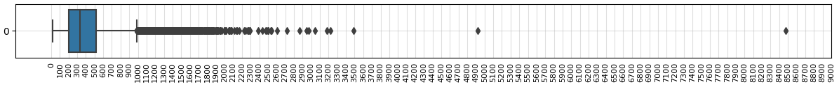
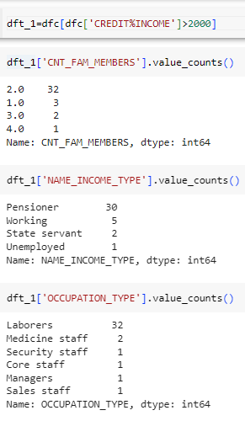
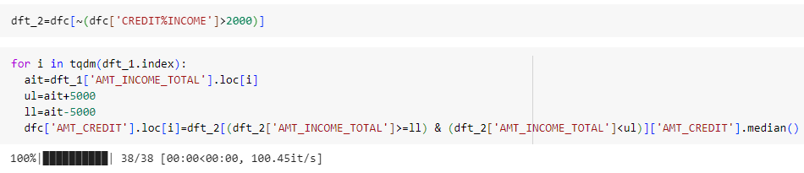
B. Identify Outliers in the Dataset: Outliers can significantly impact the analysis and distort the results. You need to identify outliers in the loan application dataset.
Task: Detect and identify outliers in the dataset using Excel statistical functions and features, focusing on numerical variables.
24. Dealing with Outliers in CREDIT%INCOME column
Action:
We considered values greater than 2000 as outliers as Credit Amount is generally repaid in multiple years and checked distribution of CNT_FAM_MEMBERS, NAME_INCOME_TYPE, OCCUPATION_TYPE for rows with CREDIT%INCOME values greater than 2000.
We can observe that most applicants were Laborers and Pensioners and had 2 Family Members. So we replaced values of CREDIT%INCOME greater than 2000 with median value of the column for rows whose AMT_INCOME TOTAL is between 5000 less and 5000 more than AMT_INCOME_TOTAL value of rows of above condition.

Slide 31

B. Identify Outliers in the Dataset: Outliers can significantly impact the analysis and distort the results. You need to identify outliers in the loan application dataset.
Task: Detect and identify outliers in the dataset using Excel statistical functions and features, focusing on numerical variables.
25. Dealing with Outliers in ANNUITY%CREDIT column
Action:
Found no issues as all the values seemed reasonable.
26. Dealing with Outliers in CREDIT%GOODS_PRICE column
Action:
We considered values greater than 150 as outliers and replaced AMT_CREDIT column value of the row with AMT_GOODS_PRICE column value of the row.

Slide 32

C. Analyze Data Imbalance: Data imbalance can affect the accuracy of the analysis, especially for binary classification problems. Understanding the data distribution is crucial for building reliable models.
Task: Determine if there is data imbalance in the loan application dataset and calculate the ratio of data imbalance using Excel functions.
The Dataset is highly imbalanced, skewed more towards Class Label 0 (No Payment Difficulty). From above Bar Chart, we can see that around 92% of Applicants didn’t had any difficulty in paying loan installments and around 8% (Class Label 1) of Applicants had difficulty in paying loan installments.
This data imbalance may give wrong predictions during modelling. So it needs to be taken care of by upscaling Data of Class Label 1 or downscaling Data of Class Label 0.

Slide 33
D. Perform Univariate, Segmented Univariate, and Bivariate Analysis: To gain insights into the driving factors of loan default, it is important to conduct various analyses on consumer and loan attributes.
Task: Perform univariate analysis to understand the distribution of individual variables, segmented univariate analysis to compare variable distributions for different scenarios, and bivariate analysis to explore relationships between variables and the target variable using Excel functions and features.
Univariate Analysis:
Most of the loan applications are for Cash Loans and very less are for Revolving Loans. This is True in reality as well.
Most of the loan applicants are Females and less are Males.
Most of the loan applicants have Nuclear Family i.e. Both Husband and Wife are together. Very less number of applicants are Single Parent i.e. Husband and Wife are not together.

Slide 34


D. Perform Univariate, Segmented Univariate, and Bivariate Analysis: To gain insights into the driving factors of loan default, it is important to conduct various analyses on consumer and loan attributes.
Task: Perform univariate analysis to understand the distribution of individual variables, segmented univariate analysis to compare variable distributions for different scenarios, and bivariate analysis to explore relationships between variables and the target variable using Excel functions and features.
Univariate Analysis:
Most of the applicants were not accompanied by anyone else followed by applicants who were accompanies by family members.
Most of the applicants had Working Income Type followed by Commercial Associate Income Type.

Slide 35

D. Perform Univariate, Segmented Univariate, and Bivariate Analysis: To gain insights into the driving factors of loan default, it is important to conduct various analyses on consumer and loan attributes.
Task: Perform univariate analysis to understand the distribution of individual variables, segmented univariate analysis to compare variable distributions for different scenarios, and bivariate analysis to explore relationships between variables and the target variable using Excel functions and features.
Univariate Analysis:
Most of the applicants had education upto Secondary followed by Higher education.
Most of the applicants were normally Married followed by Single or Not Married.

Slide 36

D. Perform Univariate, Segmented Univariate, and Bivariate Analysis: To gain insights into the driving factors of loan default, it is important to conduct various analyses on consumer and loan attributes.
Task: Perform univariate analysis to understand the distribution of individual variables, segmented univariate analysis to compare variable distributions for different scenarios, and bivariate analysis to explore relationships between variables and the target variable using Excel functions and features.
Univariate Analysis:
Most of the applicants had own House followed by applicant who were living with parents.
Most of the applicants were Laborers followed by Waiters/barmen staff.

Slide 37

D. Perform Univariate, Segmented Univariate, and Bivariate Analysis: To gain insights into the driving factors of loan default, it is important to conduct various analyses on consumer and loan attributes.
Task: Perform univariate analysis to understand the distribution of individual variables, segmented univariate analysis to compare variable distributions for different scenarios, and bivariate analysis to explore relationships between variables and the target variable using Excel functions and features.
Univariate Analysis:
Most of the applicants worked in Business Entity Type 3 followed by applicants who didn’t worked at the time. Most of these applicants were Pensioners and few were Unemployed.

Slide 38

D. Perform Univariate, Segmented Univariate, and Bivariate Analysis: To gain insights into the driving factors of loan default, it is important to conduct various analyses on consumer and loan attributes.
Task: Perform univariate analysis to understand the distribution of individual variables, segmented univariate analysis to compare variable distributions for different scenarios, and bivariate analysis to explore relationships between variables and the target variable using Excel functions and features.
Univariate Analysis:
Most of the applicants didn’t own car but had own property. Almost everyone had a Mobile Phone and most applicant had a Phone from their employer.

Slide 39

D. Perform Univariate, Segmented Univariate, and Bivariate Analysis: To gain insights into the driving factors of loan default, it is important to conduct various analyses on consumer and loan attributes.
Task: Perform univariate analysis to understand the distribution of individual variables, segmented univariate analysis to compare variable distributions for different scenarios, and bivariate analysis to explore relationships between variables and the target variable using Excel functions and features.
Univariate Analysis:
Most of the applicants didn’t had/provided home phone but most of the applicants phone provided were reachable. Also most applicants didn’t had/provided their Email IDs.

Slide 40

D. Perform Univariate, Segmented Univariate, and Bivariate Analysis: To gain insights into the driving factors of loan default, it is important to conduct various analyses on consumer and loan attributes.
Task: Perform univariate analysis to understand the distribution of individual variables, segmented univariate analysis to compare variable distributions for different scenarios, and bivariate analysis to explore relationships between variables and the target variable using Excel functions and features.
Univariate Analysis:
Most applicants’ income was less than Unit 400000 but a lot of their Credit Amount is more than Unit 400000 showing that they have applied for loans of amount greater than their Income.
Most applicants’ Annuity amount is less than Unit 50000 which is close to 10% of Income of most applicants.
The distribution of AMT_GOODS_PRICE closely follows the distribution of AMT_CREDIT.

Slide 41

D. Perform Univariate, Segmented Univariate, and Bivariate Analysis: To gain insights into the driving factors of loan default, it is important to conduct various analyses on consumer and loan attributes.
Task: Perform univariate analysis to understand the distribution of individual variables, segmented univariate analysis to compare variable distributions for different scenarios, and bivariate analysis to explore relationships between variables and the target variable using Excel functions and features.
Univariate Analysis:
We can observe that AGE column somewhat follows a normal distribution and most applicants are between age 27 and 65 i.e. most were in the working age group.
Also, most applicants had less than 8 years of work experience.

Slide 42

D. Perform Univariate, Segmented Univariate, and Bivariate Analysis: To gain insights into the driving factors of loan default, it is important to conduct various analyses on consumer and loan attributes.
Task: Perform univariate analysis to understand the distribution of individual variables, segmented univariate analysis to compare variable distributions for different scenarios, and bivariate analysis to explore relationships between variables and the target variable using Excel functions and features.
Segmented Univariate Analysis:
The first two plot shows relation between AMT_INCOME_TOTAL - AMT_CREDIT and AMT_INCOME_TOTAL - AMT_ANNUITY with segmented NAME_EDUCATION_TYPE. We can observe that applicants with higher income and higher loan credit as well as higher income and higher loan annuity have Higher Education. Also blue points are more prominent as most applicants had Secondary Education.
The last two plot shows relation between AMT_INCOME_TOTAL - AMT_CREDIT and AMT_INCOME_TOTAL - AMT_ANNUITY with segmented NAME_INCOME_TYPE. We can observe that applicants with higher income and higher loan credit as well as higher income and higher loan annuity have mostly Commercial associate type income.

Slide 43
D. Perform Univariate, Segmented Univariate, and Bivariate Analysis: To gain insights into the driving factors of loan default, it is important to conduct various analyses on consumer and loan attributes.
Task: Perform univariate analysis to understand the distribution of individual variables, segmented univariate analysis to compare variable distributions for different scenarios, and bivariate analysis to explore relationships between variables and the target variable using Excel functions and features.
Segmented Univariate Analysis:
The first two plot shows relation between AMT_INCOME_TOTAL - AMT_CREDIT and AMT_INCOME_TOTAL - AMT_ANNUITY with segmented NAME_FAMILY_STATUS. We can observe that orange points are more prominent as most of the applicants were Married but we can not observe any relation between income amount, credit amount and annuity amount with segmented family status.
The last two plot shows relation between AMT_INCOME_TOTAL - AMT_CREDIT and AMT_INCOME_TOTAL - AMT_ANNUITY with segmented CODE_GENDER. We can observe that blue points are more prominent towards right and upper side that shows Male have mostly higher income, higher credit amount and higher annuity amount.

Slide 44

D. Perform Univariate, Segmented Univariate, and Bivariate Analysis: To gain insights into the driving factors of loan default, it is important to conduct various analyses on consumer and loan attributes.
Task: Perform univariate analysis to understand the distribution of individual variables, segmented univariate analysis to compare variable distributions for different scenarios, and bivariate analysis to explore relationships between variables and the target variable using Excel functions and features.
Bivariate Analysis:
We can observe that most clients applied for Loans during Weekdays and between 9 A.M and 4 P.M. But there are also very few clients who applied for Loans late at night as well.

Slide 45

D. Perform Univariate, Segmented Univariate, and Bivariate Analysis: To gain insights into the driving factors of loan default, it is important to conduct various analyses on consumer and loan attributes.
Task: Perform univariate analysis to understand the distribution of individual variables, segmented univariate analysis to compare variable distributions for different scenarios, and bivariate analysis to explore relationships between variables and the target variable using Excel functions and features.
Bivariate Analysis:
For columns with two unique values, we can observe that for both 0 and 1 of TARGET :
Most Contract types are Cash loans
Most applicants are Female
Most applicants don’t posses own car but have own property
All applicants provided their mobile phone number
Most applicants provided their work phone number but didn’t provide their home phone number
Most applicants phone number was reachable
Most applicants didn’t provide their Email ID

Slide 46

D. Perform Univariate, Segmented Univariate, and Bivariate Analysis: To gain insights into the driving factors of loan default, it is important to conduct various analyses on consumer and loan attributes.
Task: Perform univariate analysis to understand the distribution of individual variables, segmented univariate analysis to compare variable distributions for different scenarios, and bivariate analysis to explore relationships between variables and the target variable using Excel functions and features.
Bivariate Analysis:
We can observe that for all the plot i.e. AMT_INCOME_TOTAL, AMT_CREDIT, AMT_ANNUITY, AMT_GOODS_PRICE, TARGET value of 0 has higher datapoint than TARGET value of 1 i.e. applicants with comparatively higher income, credit amount and annuity amount did not have any difficulty in paying their annuity amount in time as compared to applicants who faced difficulty in paying their annuity amount in time.

Slide 47

D. Perform Univariate, Segmented Univariate, and Bivariate Analysis: To gain insights into the driving factors of loan default, it is important to conduct various analyses on consumer and loan attributes.
Task: Perform univariate analysis to understand the distribution of individual variables, segmented univariate analysis to compare variable distributions for different scenarios, and bivariate analysis to explore relationships between variables and the target variable using Excel functions and features.
Bivariate Analysis:
For categorical columns, we can observe that for both 0 and 1 of TARGET :
Most applicants came unaccompanied followed by family.
Most applicants income type were Working followed by Commercial associate.
Most applicants education was upto Secondary followed by Higher education.
Most applicants were Married followed by Single.
Most applicants were living in their own House/Apartment followed by applicants living With Parents.

Slide 48

D. Perform Univariate, Segmented Univariate, and Bivariate Analysis: To gain insights into the driving factors of loan default, it is important to conduct various analyses on consumer and loan attributes.
Task: Perform univariate analysis to understand the distribution of individual variables, segmented univariate analysis to compare variable distributions for different scenarios, and bivariate analysis to explore relationships between variables and the target variable using Excel functions and features.
Bivariate Analysis:
For categorical columns, we can observe that:
Most applicants were Laborers followed by Waiters/barmen staff for TARGET 0. Most applicants were Laborers followed by Waiters/barmen staff for TARGET 1.
Most applicants were working in Business Entity Type 3 followed by applicants who had No Work (Pensioners and Unemployed) for TARGET 0 whereas most applicants were working in Business Entity Type 3 followed by applicants who were Self-employed for TARGET 1.

Slide 49


E. Identify Top Correlations for Different Scenarios: Understanding the correlation between variables and the target variable can provide insights into strong indicators of loan default.
Task: Segment the dataset based on different scenarios (e.g., clients with payment difficulties and all other cases) and identify the top correlations for each segmented data using Excel functions.

Slide 50
E. Identify Top Correlations for Different Scenarios: Understanding the correlation between variables and the target variable can provide insights into strong indicators of loan default.
Task: Segment the dataset based on different scenarios (e.g., clients with payment difficulties and all other cases) and identify the top correlations for each segmented data using Excel functions.
Considering 0.5 (absolute value) as threshold for high Correlation, we can observe that:
AMT_CREDIT and AMT_GOODS_PRICE are highly and positively correlated as the Credit amount request is for the Goods whose price is in AMT_GOODS_PRICE column.
CNT_FAM_MEMBERS and CNT_CHILDREN are highly and positively correlated as we observed before that all applicants were either Single Parent or had Nuclear Family.
CREDIT%INCOME and ANNUITY%INCOME, AMT_ANNUITY and AMT_GOODS_PRICE, AMT_CREDIT and AMT_ANNUITY are highly and positively correlated and have almost same Correlation values.
AMT_CREDIT and CREDIT%INCOME, AMT_GOODS_PRICE and CREDIT%INCOME are highly and positively correlated as CREDIT%INCOME is a derived feature which is directly proportional to AMT_CREDIT and AMT_CREDIT and AMT_GOODS_PRICE are highly and positively correlated as in point 1.
FLAG_EMP_PHONE and AGE are highly and negatively correlated possibly because older generation people are less used to phones.
AMT_CREDIT and ANNUIT%CREDIT, AMT_GOODS_PRICE and ANNUITY%CREDIT are highly and negatively correlated as ANNUITY%CREDIT is a derived feature which is inversely proportional to AMT_CREDIT and AMT_CREDIT and AMT_GOODS_PRICE are highly and positively correlated as in point 1.

Slide 51


E. Identify Top Correlations for Different Scenarios: Understanding the correlation between variables and the target variable can provide insights into strong indicators of loan default.
Task: Segment the dataset based on different scenarios (e.g., clients with payment difficulties and all other cases) and identify the top correlations for each segmented data using Excel functions.

Slide 52
E. Identify Top Correlations for Different Scenarios: Understanding the correlation between variables and the target variable can provide insights into strong indicators of loan default.
Task: Segment the dataset based on different scenarios (e.g., clients with payment difficulties and all other cases) and identify the top correlations for each segmented data using Excel functions.
Considering 0.5 (absolute value) as threshold for high Correlation, we can observe that:
AMT_CREDIT and AMT_GOODS_PRICE are highly and positively correlated as the Credit amount request is for the Goods whose price is in AMT_GOODS_PRICE column.
CNT_FAM_MEMBERS and CNT_CHILDREN are highly and positively correlated as we observed before that all applicants were either Single Parent or had Nuclear Family.
CREDIT%INCOME and ANNUITY%INCOME, AMT_ANNUITY and AMT_GOODS_PRICE, AMT_CREDIT and AMT_ANNUITY are highly and positively correlated and have somewhat same Correlation values.
AMT_CREDIT and CREDIT%INCOME, AMT_GOODS_PRICE and CREDIT%INCOME are highly and positively correlated as CREDIT%INCOME is a derived feature which is directly proportional to AMT_CREDIT and AMT_CREDIT and AMT_GOODS_PRICE are highly and positively correlated as in point 1.
FLAG_EMP_PHONE and AGE are highly and negatively correlated possibly because older generation people are less used to phones.
AMT_CREDIT and ANNUIT%CREDIT, AMT_GOODS_PRICE and ANNUITY%CREDIT are highly and negatively correlated as ANNUITY%CREDIT is a derived feature which is inversely proportional to AMT_CREDIT and AMT_CREDIT and AMT_GOODS_PRICE are highly and positively correlated as in point 1.

Slide 53

Result
Through this project, I was able to understand the importance of Data Analytics in Bank Loan Analysis as it provides valuable insights which helps in making Data-Driven Decisions.
In this project I was able to get insights like which features are important to predict loan defaulters, correlation between various features like income amount, loan amount, personal belongings details etc. I also got experience in Data Preprocessing like Data Cleaning, handling Outliers, Feature Engineering etc. in this project. I can communicate the insights to relevant stakeholders as per the requirements using which they can make proper data-driven decisions.
This Project has also helped me in understanding the various functions Python and its working.
Image Source: Google Images

Slide 54
Thank You
Contact: avi22nayak@gmail.com

